Slide 1
Assumption-Based Argumentation in Nuvl
Jeff Thompson
Imperial College
June 22, 2017

Slide 2
Outline
Nuvl library
Data model
Computing the framework
Nuvl World application
Next steps

Slide 3
Nuvl
Knowledge representation library in Scala
Port of 2016-ABAPlus (Python)
Scala for speed, verifiability, Java apps
def is_flat(self):
for rule in self.rules:
if rule.consequent in self.assumptions:
return False
return True
def is_flat = !rules.exists(assumptions contains _.consequent)
ABA Scala functions are callable from Java
Passes unit tests
Represent statements in Scheme
  (implies (attr LondonWet) (attr ImperialWet))
  Treat ABA_Plus “is_contrary” as simple negation: (not X)
https://github.com/jefft0/nuvl

Slide 4
What to argue about?
Physical systems with physical attributes
  Attribute of the “Imperial College location being wet”
Attributes can conflict
  “Imperial College location being wet” vs. “dry”
Tasks that transform “in” attributes to “out”
  “Raining in London last night” becomes
  “Imperial College location being wet”
Tasks are explanations for the “out” attributes
Tasks also have other “out” (conflicting?) attributes
  “Raining in London last night” becomes
  “Science Museum location being wet”

Slide 5
Attributes
Declare an attribute
  (attr ImperialWet)
Rules to inherit
  (implies (attr LondonWet) (attr ImperialWet))
Logical functions to construct attributes
  (LocationFn ImperialCollege) “attribute of being located at ImperialCollege”
Refine using subAttr
  (subAttrOf ImperialWet (LocationFn ImperialCollege))
  (subAttrOf ImperialWet
  (TimeIntervalFn 1498114800000 1498118400000))
Conflicting attributes using disjointAttrs
  (disjointAttrs ScienceMuseumDry ScienceMuseumWet) ↔
  (implies (attr ScienceMuseumDry) (not (attr ScienceMuseumWet)))

Slide 6
Tasks
Transforms a system from “in” to “out” attribute
Tasks are the assumptions
An assumed explanation for the “out” attribute
  (implies (task ImperialSprinkler) (attr ImperialWet))
  (implies (task LondonRaining) (attr LondonWet))
Task implies other attributes which can conflict
  (implies (attr LondonWet) (attr ScienceMuseumWet))
  (disjointAttrs ScienceMuseumDry ScienceMuseumWet)
Attacks come from transpose of rules
  (implies (not (attr ScienceMuseumWet)) (not (attr LondonWet)))
  (implies (not (attr LondonWet)) (not (task LondonRaining)))

Slide 7
Computing the framework
Add all rule transpositions
for (rule <- baseRules) {
for (a <- rule.antecedent)
val newAnt = (rule.antecedent - a) + rule.consequent.contrary
rules += Rule(newAnt, a.contrary) } }
(Don't need weak contraposition)
Flat framework - for each assumption X, add:
  @X → X
  ¬X → ¬@X
Actually compute with the “@” assumptions
Generate preferred extensions
Computed grounded extension
Compute deduced (attr $A) of grounded extension

Slide 8
Scenarios
A scenario for each preferred extension
Compute deduced (attr $A) of preferred extension
“Conflicting” assumptions = preferred - grounded
Select a scenario to change event status

Slide 9
Event status
Nuvl World displays the status of each event:
  Deduced from grounded extension ☺
  Deduced in the selected scenario
  Deduced in non-selected scenario

Slide 10
Nuvl World
Calendar application in Java
2 million locations + time zones from Wikidata
Enter events (attribute with location and time)
Enter dependencies (tasks from “in” to “out”)
Compute scenarios, display conflicts
Resolve conflicts
  Remove a conflicting event
  Add an event that counter-attacks

Slide 11
Nuvl World Demo
Assumptions
  (task ImperialSprinkler)
  (task LondonRaining)
  (task ScienceMuseumDry)
Rules
  (implies (task ImperialSprinkler) (attr ImperialWet))
  (implies (task LondonRaining) (attr ImperialWet))
  (implies (task LondonRaining) (attr ScienceMuseumWet))
  (implies (task ScienceMuseumDry) (attr ScienceMuseumDry))
  (implies (attr ScienceMuseumDry) (not (attr ScienceMuseumWet)))
Attacks
  (implies (not (attr ScienceMuseumWet)) (not (task LondonRaining)))

Slide 12
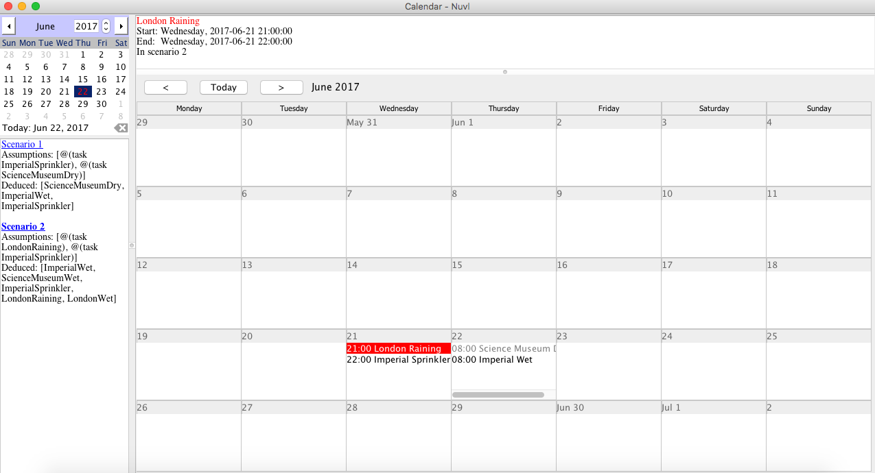
Nuvl World screen shot

Slide 13
Next steps
Improve the display of conflicts
Stress test performance with many events
Automatically generate tasks (explanations)
Import external events
  From other users: A friends sends a meeting request
  News feeds: Notice of airline strike
Use ideal as the “happy” extension?
Best way to narrow scenarios?
  Use ABA+ preferences? (e.g. more reliable source for explanations, prefer subway to driving)
  Artificially add attacks?
  Reject scenarios that don't derive “pinned” conclusions?
    More statuses (colors) for events in “rejected” scenarios

